Slide 1

Other clusters in unsupervised learning

Slide 2
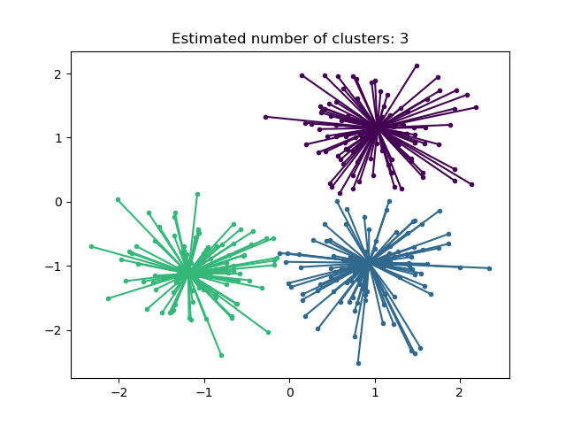
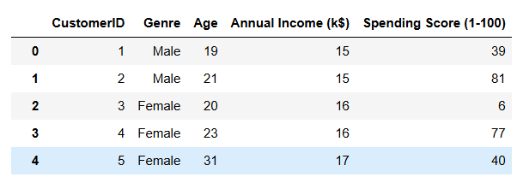
A. Affinity propagation
1.Like all others cluster algorithms this also helps in predicting the clusters.
2. Initilly it also considers all datapoints as a cluster.eg lets say we hv the following data :
3. In the given table we hv 5 datapoints each considered as a cluster.
4. Now we r going to find similarity matrix between each data point by calculation the squared negative Euclidean distance so that the (–ve) value close to 0 has highest similarities.
5. Once the similarity matrix is calculated we find the median of all the similarity matrix for each datapoint. Lets say wen i=0, k(possible exemplars can be 1,2,3,or4)so we find the similarity matrix for I with all possible ks and we get the 1st 5 values in the first iteration. These 5 values gets arranged in an order

Slide 3
6. From this order we calculate the median of 5 values which could be the potential exemplar of i=0. this is called preference, which we do to train the model based on a bias and an outlier which will result in improper clustering.lets say this is the similarity matrix for each point:
7. Once the similarity matrixes and preference r calculated,the algorithm finds the responsibility and availability for each datapoint and update the iteration.y? to find the potential exemplar for that particular i.
8. Responsibility tells us how well I sees another datapoint as an exemplar(exemplar is the potential centre of a cluster)
9.Availability tells us the support I gets from other datapoints to choose a data point as an exemplar.
10. Lets say for i=point0, we calculate responsibility and availabity wen k=point1/point2/pont3/point4, the one datapoint with highest responsibility and availability is the potential exemplar for i=point0.
 | Point 0 | Point 1 | Point 2 | Point 3 | Point 4
Point 0 | 0 | -1768 | -5332 | -6800 | -1600
Point 1 | -1768 | 0 | -5300 | -6900 | -1500
Point 2 | -5332 | -5300 | 0 | -1500 | -2700
Point 3 | -6800 | -6900 | -1500 | 0 | -6000
Point 4 | -1600 | -1500 | -2700 | -6000 | 0

Slide 4
responsibility
r(i,k)=s(i,k)−k′=kmax​(a(i,k′)+s(i,k′))( initially the availability and responsibility values r 0 and then it gets updated after each iteration.)
 | Point 0 | Point 1 | Point 2 | Point 3 | Point 4
Point 0 | 0 | -1768 | -5332 | -6800 | -1600
Point 1 | -1768 | 0 | -5300 | -6900 | -1500
Point 2 | -5332 | -5300 | 0 | -1500 | -2700
Point 3 | -6800 | -6900 | -1500 | 0 | -6000
Point 4 | -1600 | -1500 | -2700 | -6000 | 0

Slide 5
AVAILABILITY
 | Point 0 | Point 1 | Point 2 | Point 3 | Point 4
Point 0 | 0 | -1768 | -5332 | -6800 | -1600
Point 1 | -1768 | 0 | -5300 | -6900 | -1500
Point 2 | -5332 | -5300 | 0 | -1500 | -2700
Point 3 | -6800 | -6900 | -1500 | 0 | -6000
Point 4 | -1600 | -1500 | -2700 | -6000 | 0

Slide 6
11.Now the 1st iteration gets updated and we start the 2nd iteration where i=1.in our case we will have a total of 5 iterations cos we have 5 datapoints.
12. This process continues till convergance which means no more datapoints exists to be added to the clusters and the algorithm has found stable compact clusters.
13 sometime the model while predicting clusters reaches the convergance fast or iterates the message quickle causing an error to prevent this we use another parameter called damping which we set in a range of 0 to 1 ,where near to 1 means the reaching convergance will take time but the quality of clusters formed will be accurate and good.
14 now to see the final potential clusters or exemplars we plot the graph uding seaborn and name the each exemplar based on the relation between the important features which is important for detailed targeting. In our instance it’s the annual income and spending score.

Slide 7
B: Mean Shift Clustering
In this algorithm each datapoint is considered as a centroid of a cluster unlike k means we don’t hv to predefine the no. of centroids it trwats each datapoint as a centroid.
2. the goal of the algorithm is it forms clusters by moving to the region of highest density of datapoints.
3. how? By using bandwidth which is like a circle drawn around each datapoint with a radius either we can manually give or estimate using a method estimate_bandwidth(x) of scikit.
4. for eg: if a bandwidth of 5 is given for each datapoint(lets say point0). Then the neighbours within the radius of 5 belongs to that cluster and point 0 moves to a position which is the mean of the distance of point 0 and the neighbouring datapoints within the bandwidth.

Slide 8
5.And if 2 or more bandwidths overlap the centroids in these bandwidths merge to form a single cluster as shown.
6. This shifting and merging continues until convergence reaches.
7. If u want to see which cluster no is for a particular datapoint after training the model , run the code
Model.labels_
8. If u want to see the clusters formed and the relation btw features based on which the clusters r formed plot a graph using sea born.

Slide 9
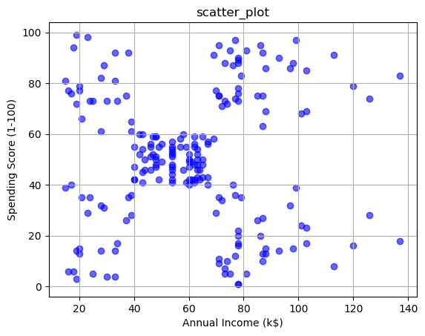
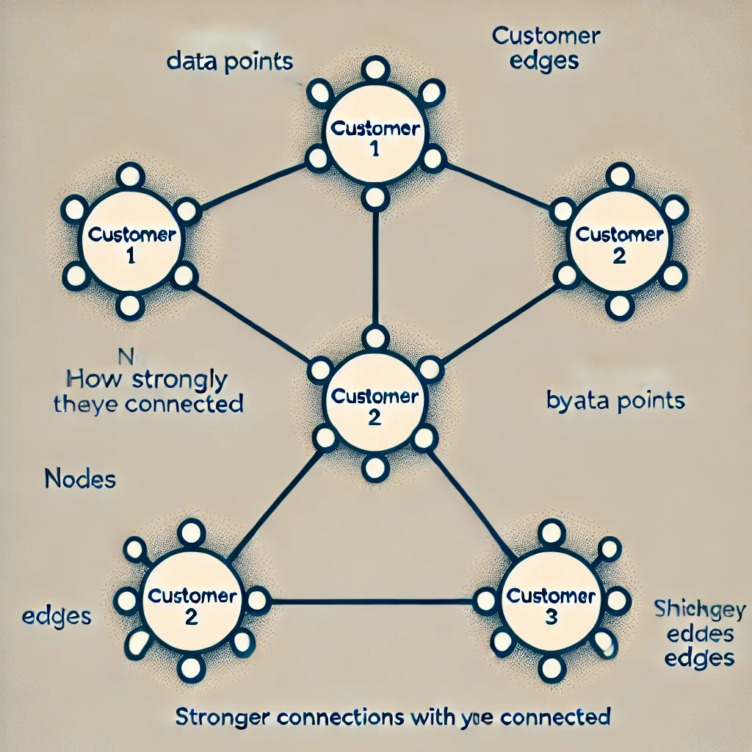
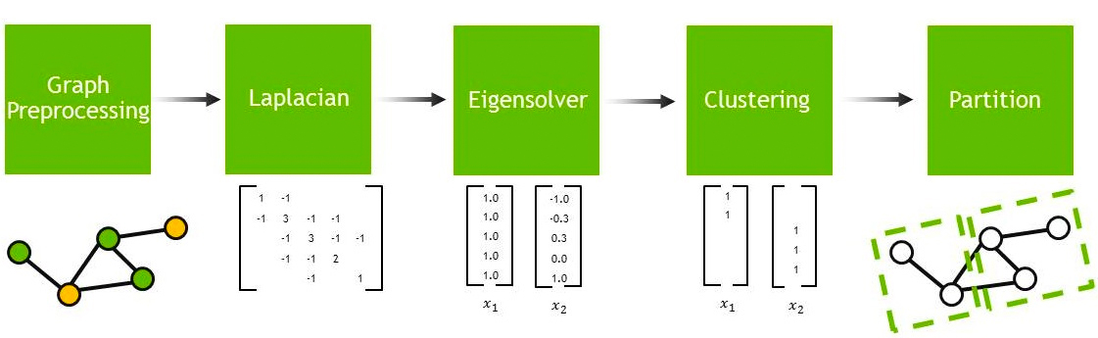
C. Spectral Clustering
1.From the dataset we split the data.the data points are considered as nodes once we run the algorithm each node starts formsing edges with the datapoints with strong similarities that vary with weight of the edges.which is represented on a graph as follows:
2. Then it calculate the similarity matrix and degree matrix
3. The it calculate the Laplacian matrix using similarity and degree matrix
4. We find the eigenvectors and the lowest non0 eigenvalues from the lapalcian matrix by Spectral decomposition
5. This eigenvalue on the graph is where we split the clusters which is the partition of clusters
ADVANTAGES:
1.Used for odd shaped clusters
2. Doesn’t give biased clusters when there r outliers
3. Used for complex data

Slide 10
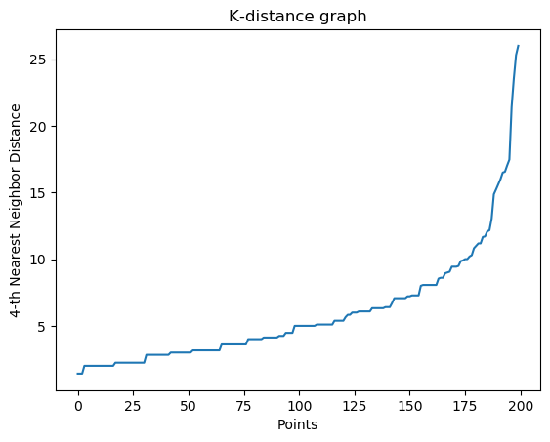
D.DBSCAN
1.In DBSCAN, clusters r formed only wen each datapoint satisfies 2 criteria. That is it should have a minimum no of neighbours(min_samples>=2*D; D=dimension of the datset) and the eps= its like a radius around a data point within which it should have min_samples of neighbours including itself. Then it’s a core point
2. If a datapoint is within the eps value but has <= min_samples>=2*D, then it’s a border point
3. A datapoint which does not satisfy these 2 criteria is a “noise” and is labelled as a negative cluster.
4. For our data(Mall_Customers.csv) we calculate eps form nearest neighbour graph, here eps is calculated as the point where the nearest neighbour distance steeply increase. Here its around 11 or 12 so the min_samples = n_neighbors as seen in knn should be seen within a distance of 12 from that data point.

